Slide 1
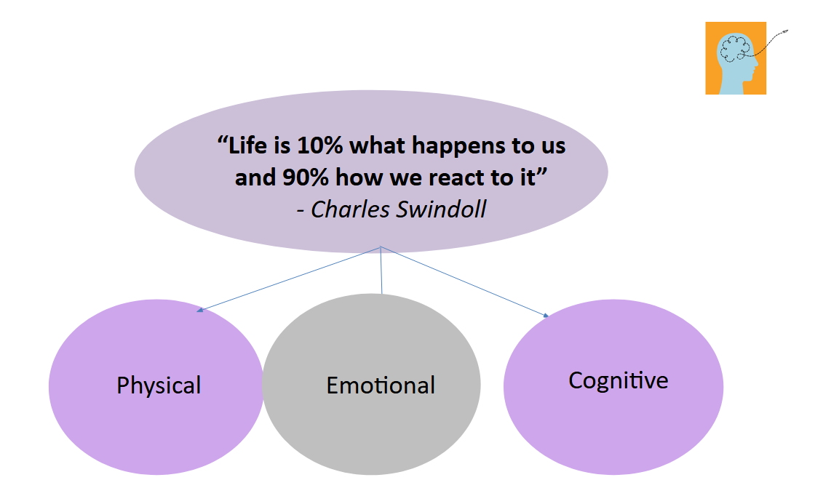
THE ZONES OF REGULATION
Supporting Emotional Regulation
https://www.youtube.com/watch?v=dnBAU8Co6PA

Slide 2
THE ZONES OF REGULATION
Aims:
Overview of Self-Regulation
To understand how ‘The Zones of Regulation’ is applied in our school.
Share real life scenarios
To explore strategies and tools for each zone to use at home
Questions

Slide 3

Self- Regulation
Self- Regulation put simply is our ability to recognise and manage our emotions, behaviour and thinking in the context of everyday life. Self-regulation can go by many names, such as self-control, self-management and impulse control. It is defined as the best state of alertness of both the body and emotions for the specific situation.
Scenario: Morning Rush
7.45am Mum has important meeting.
Child has a toileting accident.
Mum’s immediate response is to dysregulate and shout
Regulation in Action
Pause and breathe- Parent recognises she’s in the
yellow zone and takes 3 deep breaths.
Self Talk- I can stay calm, it’s ok if I am late,
Accidents happen.
Quick plan: Let’s change and be on our way.
She helped the child remain calm and feel safe.

Slide 4
What are the Zones?
Uses 4 coloured Zones to categorise feelings and emotions.
What do the ZONES of Regulation® do?
The ZONES are designed to help YOU self regulate by recognising when you are in different zones and how to use strategies to change or stay in the zone you are in.
For example, when a child plays in the playground, it is beneficial to have a higher state of alertness, however, that same state would not be appropriate in say the classroom learning. So ,it is important you all become aware of your different zones and when it is appropriate to be in that zone.

Slide 5
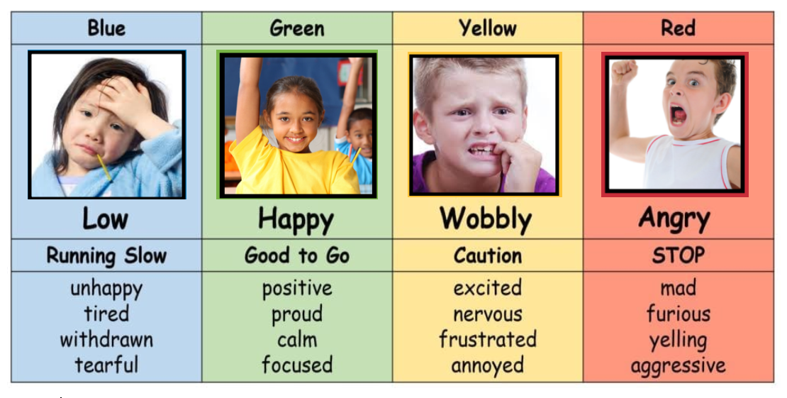
THE ZONES OF REGULATION
And remember….. there is no such thing as a bad ZONE!
Red Zone: Is not naughty or bad
Some zones are useful such as Blue Zone for bedtime and Yellow Zone when we are excited about going on Holiday!
Which Zone would be optimal for learning?

Slide 6
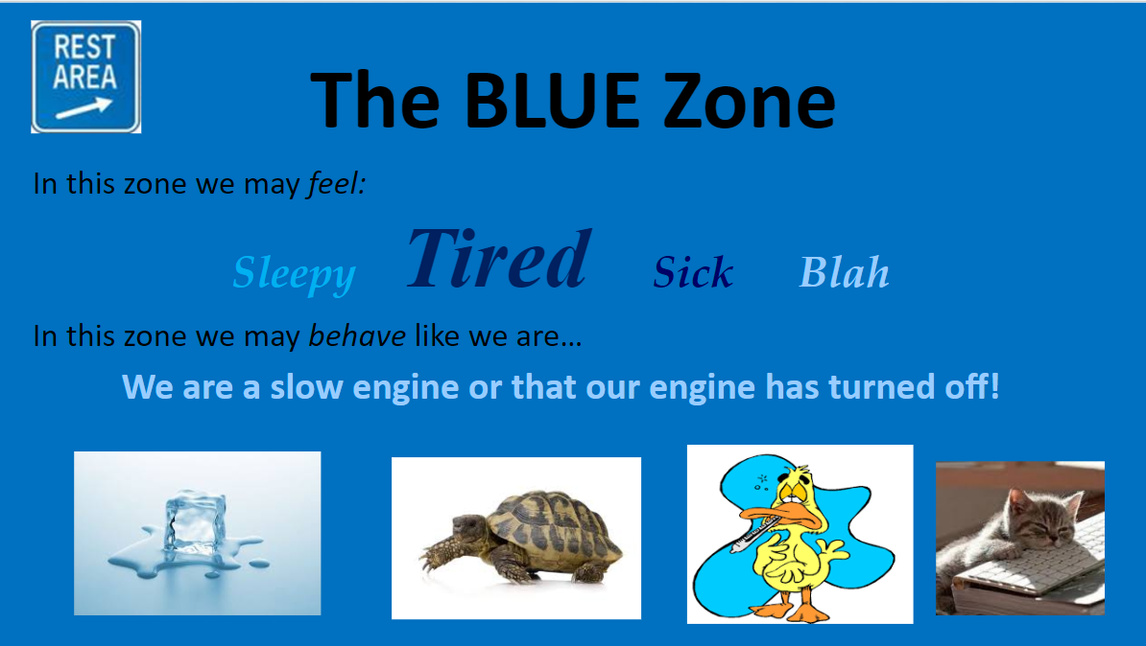
The Blue Zone
Used to describe low states of alertness and down feelings.

Slide 7
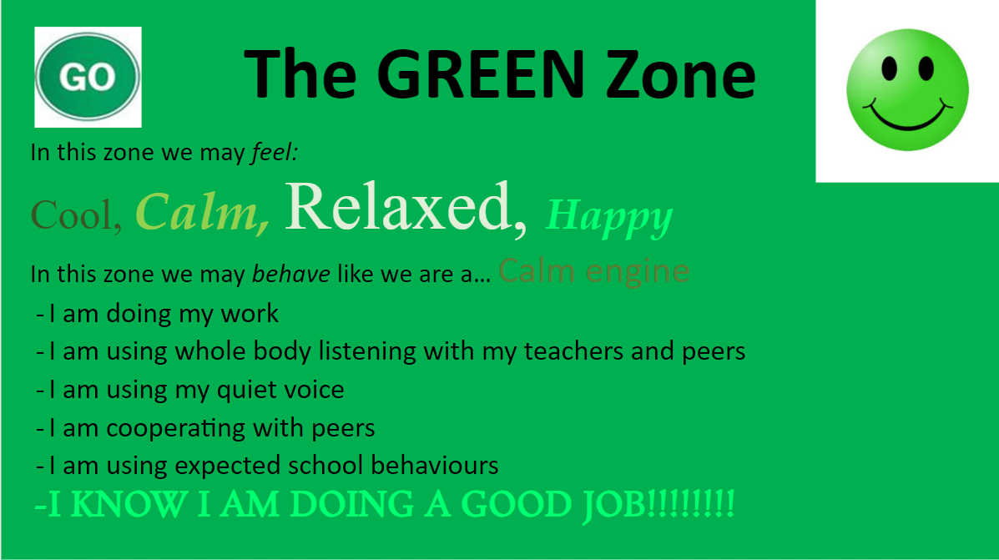
The Green Zone
Used to describe calm states of alertness.

Slide 8
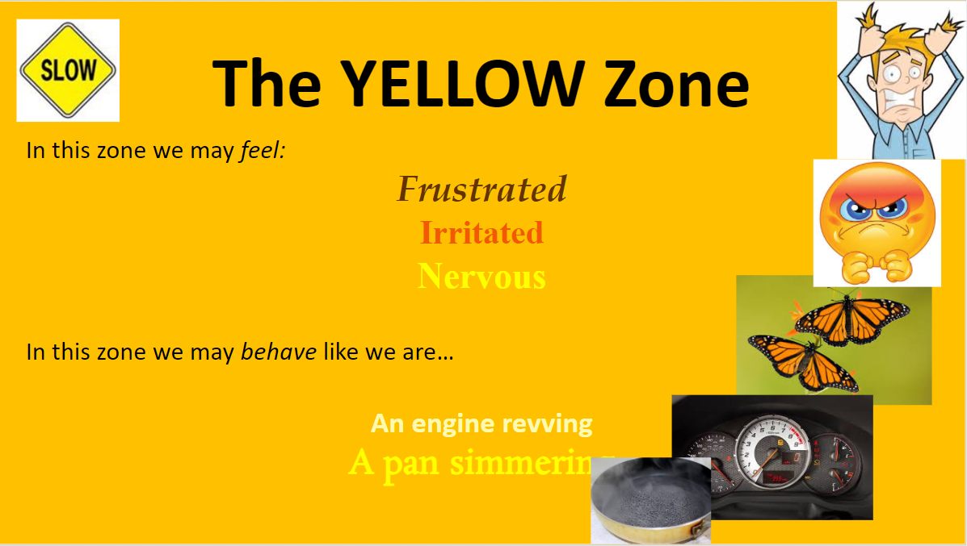
The Yellow Zone
Used to describe heightened state of alertness; however we have some control

Slide 9
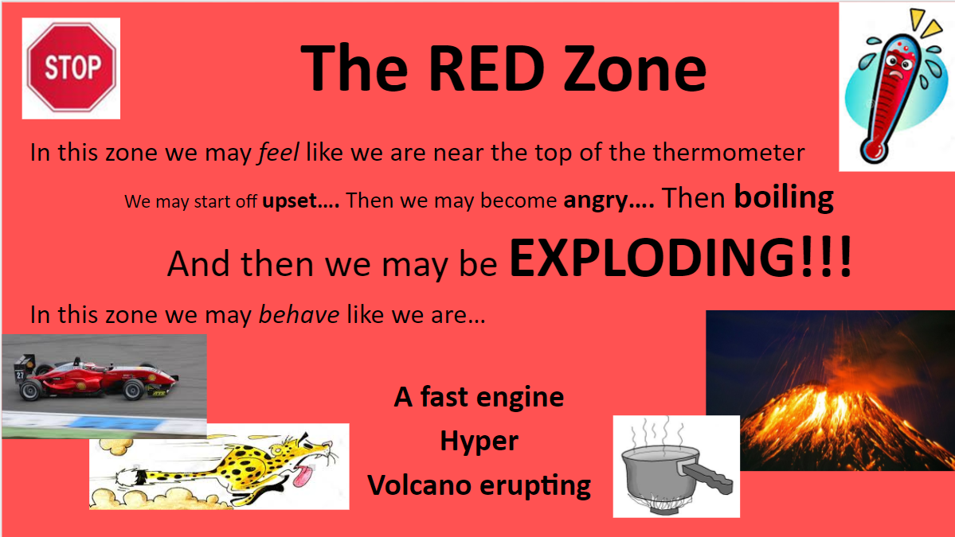
The Red Zone
Used to describe extremely heightened states of alertness and intense emotions.

Slide 10
How are you feeling today?
It’s important that we model ‘checking in’ with how we are feeling within ourselves. Often a lot of children are not asked ‘How are you today?’
How do we use the Zones of Regulation at school?
Zones of Regulation chart to invite children everyday to check in with how they are feeling.
Teachers model using the Zones language- I am feeling a bit blue today, I need to drink some water and do some movement
The chart supports teachers in visually seeing which Zone children are in and can support adapting teaching strategies.
Regulation Area in all classrooms with a Tool Box

Slide 11

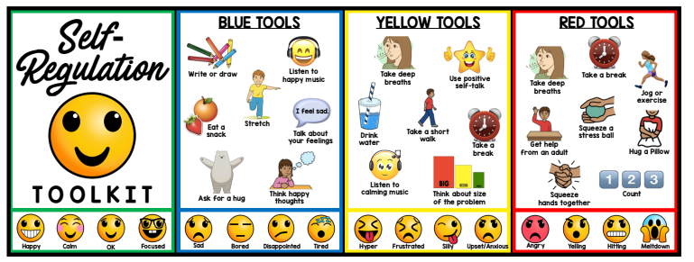
Toolbox
How do we help children to move back to the Green Zone?
A toolbox is a strategy to support children to move to the Green Zone by regulating themselves through fidget toys, sensory timers, cuddly toy, drawing.
Teach children how to use these tools when they are in the Green Zone.
Notes:
Vagus nerve- deep breathing, sends signals that we are safe.

Slide 12
How can you support your child at home?
Toolbox of strategies to support regulation: Discuss with your child what should go in their Regulation Area and explain this is where they can come to when they need support to get back to the Green Zone.
Regulation Area at home: Cosy area with sensory timers, fidget toys, a cuddly toy
Co- Regulation: by regulating yourself, remaining calm in difficult situations will support your child to find their own regulation

Slide 13
Co-Regulation: Children often copy and turn to their trusted adults to help
Them manage big and difficult feelings. How we talk to children impacts their nervous system.
https://www.youtube.com/watch?v=RRMBHQ-Bmk0
WINE sentence starters instead of Why are you crying?! What are doing?!
I wonder if you could tell me what that felt like for you?
I noticed that you were upset when your brother did not share, could you tell more about that?
Notes:
Regulate yourself first, then co regulate.

Slide 14
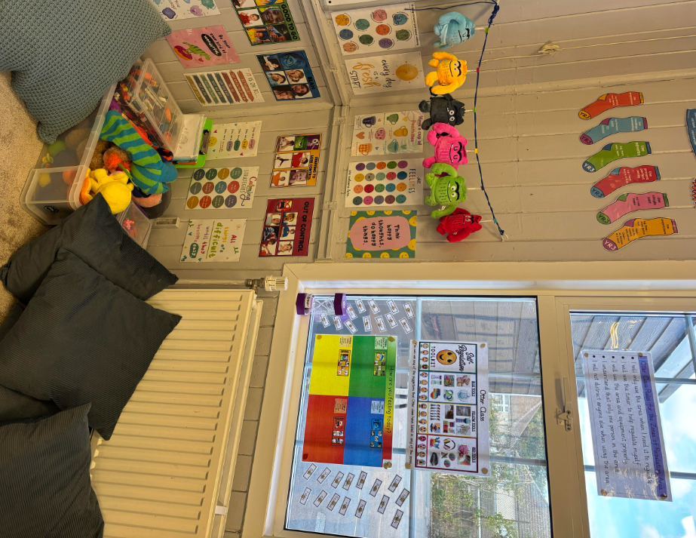
An example of one of our Regulation Areas in a classroom.
Notes:
Amy

Slide 15

Questions?
Useful links
Self-Regulation Curriculum | The Zones of Regulation
https://www.nelft.nhs.uk/havering-mental-health-and-wellness-teams/

